Slide 1
Debt 1: Introduction to Money Advice

Slide 2
This session will cover…
the five-step advice process for dealing with a client with debt problems
the importance of finding out the whole situation
emergency situations, priority and non-priority debts and liability issues
how to help a client maximise their income
essential expenditure
the main elements of a financial statement and the Common Financial Statement
Notes:
What is debt? An obligation to repay monies owed. Emphasising a lot of clients/trainees are in debt e.g. HP, mortgage, etc. but this then becomes problem debt for some people.. Activity: Flipchart asking for causes of problem debt/how clients may become unable to continue payments/change of circ’s

Slide 3
Causes of problem debt
Relationship breakdown
Marriage
Zero-hours contract
Education
Welfare reform
Change in employment e.g. reduced hours, temporary contracts
Ill-health
Pregnancy
Moving home
Bereavement
Retirement

Slide 4
The five-step process
Find out the whole situation
Deal with any emergencies
List all creditors and debts
Maximise income
Identify essential expenditure and prepare a financial statement
Notes:
Referring to flipchart activity – finding out causes of debt, type of debts, solely liable/jointly liable, action taken already by client or creditor?
We will look into what emergency debt is and the difference between this and priority debt. Working out whether immediate action needs to be taken.
Need the full picture to be able to accurately discuss options and identify risks for the client; creditors shouldn’t get preferential treatment e.g. some clients pay Provident agent as it’s a door to door visit
All clients should be offered a QBC, preferably at their first visit to avoid longer waiting periods if there is an entitlement; discuss perhaps grants available, etc.
Some clients feel credit cards, etc. are expenditures as they are keeping on top of the payments to them, however, this is treated as a debt; look at Bureaux Debt Pack and explain the CFS

Slide 5
Step 1: Find out the whole situation
Explain the advice process and give reassurance
Explain confidentiality and right to decide
Gather information about client’s:
personal circumstances
creditors and debts
income
assets
household expenditure.
Notes:
Activity: Exercise 1

Slide 6
Step 2: Deal with any emergencies
Identify any emergencies such as:
client due in court the next day
essential services such as fuel about to be disconnected
client at risk of eviction
With support, take any necessary action
Notes:
Client due in court – can be quite common – discuss personal experiences of sequestration cases where last minute phone calls are needed just to explain to clients what will happen
Fuel disconnections – very uncommon and can usually be prevented through things like Fuel Direct; prepayment meters installed; payment to arrears taken from top-up’s; all companies should have vulnerable person’s policy e.g. for those with disabilities or elderly that they have tried everything possible before moving for disconnection.
**HANDOUT FUEL DISCONNECTION FIGURES**
A threat of eviction is quite different to the actual procedure starting as court action must be taken.. This can give the client time to remedy the situation.
Session Support Worker or Manager always on hand and Money Advice Workers can be called as well – help with what action creditors may take and assess risks but can depend a lot on what information the client has provided. With emergency situations you can contact the Money Advice Workers to try and fast track the case but we still expect the client to be able to provide as much information as possible.
Activity: Exercise 2 workbook

Slide 7
Step 3: List all creditors and debts
Collect details of all creditors and list all debts, including those with no arrears
Check client is liable for debts
Check the contracts are valid and enforceable
Divide debts into priority and non-priority
Contact the creditors (first contact / holding letter)
Notes:
Collecting details – some clients will prioritise differently due to persistent contact from certain creditors but we need details of them all
Liability – Discuss Prescriptions and Limitations (Scotland) Act – 5yr prescription debts and so credit reports can be helpful (we can apply for these, each Manager has access)
Also checking for joint liability as we may need to also discuss with partner
Validity/enforceability – Prescriptions and Limitations Act as not enforceable if no court action within 5yrs – creditors good at picking this up themselves anyway;
Does client have copies of contracts if they are querying liability? Careful when contacting creditors not to admit liability – CCA can be used to gain copy of original agreement
Pri and non-pri – Making client aware why priority debts should be paid first (due to sanctions that can be imposed; always encourage clients to ‘pay what they can’
Advisers can deal with single debts for clients! Income and expenditure should still be completed and are available on workroom computers
Activity: Flipchart to identify different priority and non-priority debts
Activity: Exercise 3

Slide 8
Priority and non-priority debts
Priority debts
Non-priority debts
serious action (sanctions) can be taken against the client if they don't pay what they owe
other debts may also be considered priority debts due to client need
would not result in such severe action against the client
Notes:
Priority debts: other debts considered priority can be HP goods and family/friends loans to clients
Identified by sanctions such as: imprisonment; eviction; loss of essential goods; disconnection
Non-priority debts – usually their only sanction will be to raise a claim in court for monies owed

Slide 9
Step 4: Maximise income
Is the debt household or individual debt?
Include all relevant persons’ income
Find other ways to maximise income
Notes:
For example paying things for their children/partner?
Relevant persons – if debts solely in clients name we do not take details of the partner, however, if they agree bills paid jointly and they both want to help with debts then both income details rqd.
If not joint then we can add a contribution from partner to bills rather than including their income
Non-dependant’s encouraged to contribute
Maximising income – Turn2us to identify grants; Scottish Welfare Fund CCGs e.g. clients moving home; coming out of prison, etc.
QBC offered and baring in mind other details client may give you about health for sickness benefits
Discuss case recently – client abused by son and had sought help previously for this, client had non-dep ded’s from her HB because he was living there and working and son would not pay client. Applied for DHP to help client with the non-dep ded’s and explained situation, she was awarded £10p/wk towards this for 6months minimum.

Slide 10
Step 5: Prepare financial statement
Work out what household / client needs to spend on essentials (‘essential expenditure’)
A number of guidelines have been developed to assist with this process
Prepare the Financial Statement – a document that gives a complete picture of the client’s financial circumstances, including all income and expenditure
Trigger Figure amounts August 2015-16
 | First Adult | Additional Adults | Children Under 14 | Children 14 - 18 | Own Vehicle
Phone | £45.00 | £20.00 | £10.00 | £15.00
Travel | £96.00 | £83.00 | £33.00 | £56.00 | £202.00
Housekeeping | £348.00 | £236.00 | £96.00 | £170.00
Other Expenditure | £176.00 | £118.00 | £67.00 | £104.00
Notes:
Essential expenditure in debt pack
Guidelines – Explain trigger figures
As advisers you will be manually taking down the information to pass to MAW eventually, we will then formally put this on the system to create a financial statement

Slide 11
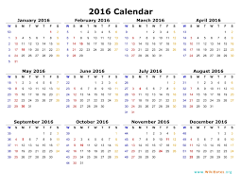
Weekly to monthly
Start with weekly sum
Multiply by 52 weeks
Divide by 12 months
So, for example, if food costs £99 / week:
£99 × 52 ÷ 12 =
£429 per month
Notes:
Important with debt pack to distinguish between 4wkly and monthly figures. All benefits except Universal Credit will be weekly or 4wkly NOT monthly.

Slide 12
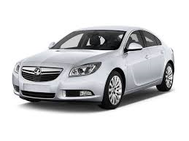
Other expenditure
Child-related
Car / travel
Personal
Work-related
Other household costs
Notes:
If anything seems to be excessive we would ask for good reason for this as depending on their options we could have to explain or show proof of this.

Slide 13
Case Study: The Cramb’s
Using your estimated expenditure for the Cramb’s from the Personal Finance training, compare this now by using the trigger figures.
Think about the following:
Do the clients appear to be living within their means?
Do they exceed the expected trigger figures?
Do you feel their expenditure is unreasonable?
What do you think of the idea of having trigger figures in money advice?

Slide 14
Summary
Clients get into debt for many reasons, many of which are outwith their control
The five-step debt process underpins the handling of debt problems
Advisers must be able to identify priorities, emergencies and liability at the initial interview
The adviser should collect all income and expenditure details & info on debt checklist (debt packs should not normally be given home)
Debt 1
Many reasons
5-step process
Priorities, emergencies, liability
Income and expenditure

Slide 15
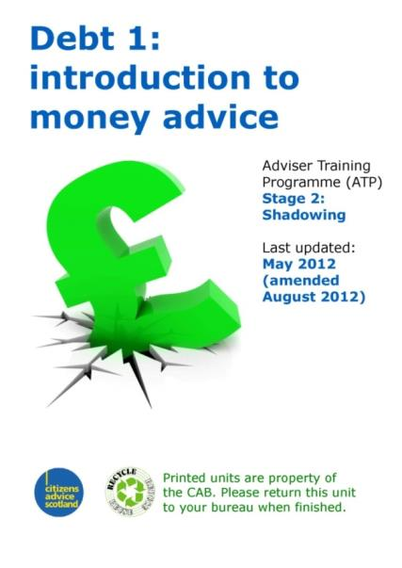
Training unit
Can be found as part of this topic’s learning route (course) on CASlearn

Slide 16
Credits
Copyright
The material contained in this presentation is the copyright of The Scottish Association of Citizens Advice Bureaux – Citizens Advice Scotland (Scottish charity number SC016637) and may not be reproduced, except by bureaux, without the written consent of the CAS Training Team.
Images
Please note that the images used in this presentation do not depict actual people or events; they are used for illustration purposes only. Non-CAB images are courtesy of istockphoto and/or Microsoft Clip Art.

