Slide 1

How To Carry Out a Benefit Check

Slide 2
This session aims to…
Explain the best way to carry out a benefit check
Give you an understanding of the means-testing process
Enable you to match a client’s situation to their potential entitlement
Notes:
Part of a series which includes using the calculation software
Apologies for running out of sequence and sickness benefits usually would have taken place….. Which Benefits session in week 2 is linked into this (this is next step)

Slide 3
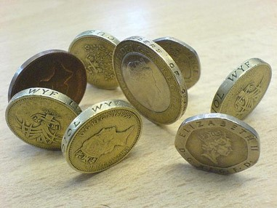
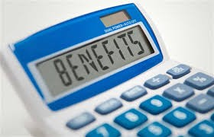
Why do we offer every client a benefit check?
Complex benefit system
Maximising Income
Huge number of entitlements go unclaimed
Impact on other, presenting issues (rent, council tax, debts)
Change of circumstances
Preventing Overpayment
Change of circumstances
Notes:
CAS membership requirement that ALL offered – Doesn’t mean done at that point…..
Some stigma around benefit claiming and lack of understanding of system to blame
Various groups project figures from £10 to £15 billion in total unclaimed benefits (things like pension credits, housing benefit)
Some benefits can trigger others, but the stages to get there are complex
ASK THEIR EXPERIENCES SO FAR IN OFFICE>>>>>

Slide 4
The Entitlement Checking Process
Identify the client’s circumstance
Use a benefit checklist
Consider benefit possibilities
Check eligibility
Check entitlement to non means-tested benefits
Calculate entitlement to means-tested benefits
Notes:
Broken down, at it’s simplest this is the process – Like most things at CAB, the process is a bit more reactive and not always straight forward getting to this point!
We’ll work our way through the steps

Slide 5

The client’s circumstances
What information do you need in order when working out a client’s entitlement?
Notes:
Now we know where to look, we need to think of info to gather?
EXERCISE : Use flipchart (or In groups make lists)

Slide 6

What affects people’s benefit entitlement?
Ill health, disability
People in the household
Caring
Working Hours
Income and Capital
Mortgages
Residency status
National Insurance contributions
Notes:
Lots of things have an impact and need to be taken into account….. Discuss and ask why?
Immigration and residency effects (EU, UK out of country long time …) recourse to public funds
Non-dependents income
How long in employment before (NI contruibutions)
When we talk about checking entitlement we need to be aware that different benefits have different criteria and that it isn’t universal – Think back to “Which Benefits?” session!!!

Slide 7
Premiums
Premiums can apply to means tested benefits
There are seven types of premium:
  Disability premium
  Severe disability premium
  Enhanced disability premium
  Pensioner premium
  Carer premium
  Family premium
  Disabled child premium

Slide 8
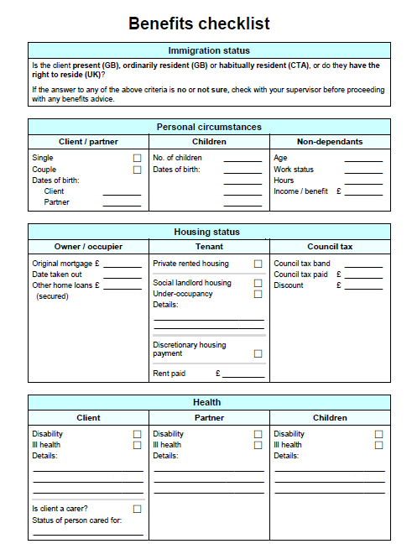
Notes:
A TOOL TO HELP YPU GET ALL NEEDED INFO / A REMINDER PROMPT (will see advisers in and out of interview rooms to get more info when not using it!)
On The Hub (internal info system) to download or through CAS website…. May find Basic Info Questions Handbook (to be given at end of BTP and available in office) easier to use
GIVE HANDOUT

Slide 9

Types of Benefits
Different types of benefits have different (and multiple) eligibility criteria:
  Means tested
  - Low income or no income
  Non Means tested
    Non contributory benefits
    Contributory benefits – based on NI contributions
Notes:
We need to be aware of what type of benefits we’re looking a when carrying out a benefit check
Most unclaimed benefits are means-tested and this is the starting point for a benefit entitlement check – Important to have a basic understanding of means teasting
EXERCISE – ASK TO NAME SOME MEANS-TESTED???

Slide 10

Means-Tested Benefits
Universal Credit
Jobseekers Allowance
Employment & Support Allowance
Income Support
Pension Credits
Working Tax Credits
Housing Benefit and Council Tax ‘Reduction’
Notes:
Won’t look at how to work out Tax Credits today (separate session)
Explain/remind that there are different situations and permeations for each

Slide 11
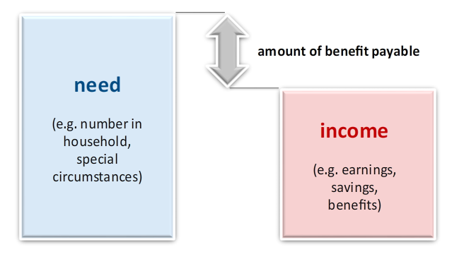
What is the “means test”?
A comparison between an individual/couple’s ‘need’ and ‘means’
APPLICABLE
AMOUNT
(NEED)
CLAIMANT’S
FINANCIAL
CIRCUMSTANCES
(MEANS)
Notes:
At its simplest……..
What is need? The state defines this under a system of applicable amounts

Slide 12
Means-Testing: Applicable Amounts
The law says there are basic levels of income people need to live
Personal Allowance
£
Notes:
As the very beginning, jumping off point – This is often referred to as a claimant’s NEED
The basic living amounts everyone should receive – If a claimant has a source of income, but it is below these amounts, then relevant benefits can be applied to ‘top-up’ their income to these levels
NOTE: Differ depend on benefit’s criteria

Slide 13
Applicable Amounts
Personal Allowance
£
However, that ‘need’ can vary depending on circumstances:
PART OF A
COUPLE
HEALTH
ISSUES
CHILDREN
CARE FOR
SOMEONE
Notes:
The level of need increases with each applicable amount – Applicable amounts on top of the basic are often called “premiums” for work age, “”additions” for retirement age and “elements” for Universal Credits;
An amount is then set for each of these ‘needs’

Slide 14
Applicable Amounts
The claimant’s Applicable Amount is the total amount once all their ‘need’ is added up
Remember, not every person has the same ‘needs’, so not everyone gets the same amount
HEALTH
ISSUES
£
CARER
£
PART OF A COUPLE
£
Personal Allowance
£
Personal Allowance
£
Personal Allowance
£
Person 1
Person 2
Person 3
Notes:
EXERCISE A (pairs)
The reason we do this is because clients may be receiving an award that doesn’t take into account all the elements (In my experience different benefit agencies only talk when it’s bad!), such as non-auto SDP
WILL COME BACK TO THESE CASES IN A MINUTE FOR EXERCISE B!!!!

Slide 15
The “means test”
The difference between the totalled applicable amounts and the client’s income (‘means’)
Applicable Amount [need]
Health issues
Personal allowance
Client’s financial circumstances [means]
Savings
Partner’s income
Part of a couple
Amount of benefit payable

Slide 16
What income is looked at? (‘means’)
Wages / Self-employed earnings
Savings / Capital (creating a ‘Tarrif Income’)
Partner’s income etc.
Most benefits count as income, but Personal Independence Payment & Attendance Allowance don’t.
Notes:
Savings – People ask often! Give handout
Tariff income – A charge put on for savings over amounts (usually 6-16k)
There are benefit guidebooks (DRHB & CPAG) – ALWAYS CHECK THEM IF IN DOUBT (Some are difficult - injuries comp etc, disregarded income on JSA is £5pw, UC different);

Slide 17
Non Means-Tested Benefits
Disability Living Allowance (DLA) & Personal Independence Payments (PIP)
Attendance Allowance (AA)
Carer’s Allowance (earnings limit)
Child Benefit*
State Retirement Pension
Contributions-based JSA & ESA
Notes:
Explain/remind that there are different situations and permeations for each – You would check criteria rather than means
Benefits where it’s either paid because of NI contributions (stamp) or solely because of need
*Child Benefit is a slight anomoly, given £50,000 ‘taxation’

Slide 18

The Calculation
STEP 1 – Check non-means eligibility criteria (non contributory and contributory)
STEP 2 – Work out applicable amount/personal allowance/minimum guarantee
STEP 3 – Work out the income/capital
STEP 4 – Compare income and the applicable amount/personal allowance/minimum guarantee
Notes:
If you chose, you can carry out checks manually… However, we use software

Slide 19

Benefit Checking Software
Quick Benefit Calculator (QBC, on office PCs)
Turn2Us (www.turn2us.rg.uk)
Entitled to (www.entitledto.co.uk)
Notes:
To get the most out of these programmes, you need to understand what info it needs and WHY it needs it – You need to know the eligibility for each benefit (check Advisernet/disability books)

Slide 20
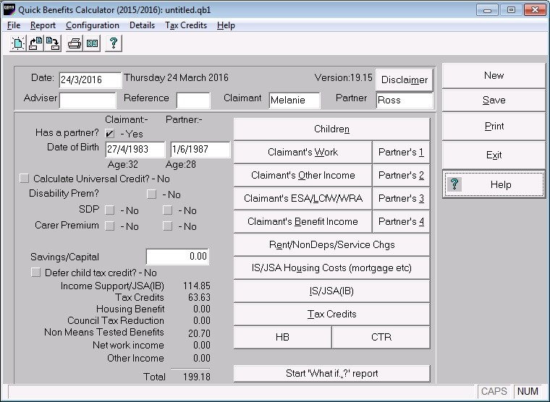
Quick Benefit Calculator
Notes:
We run a session on this, though it is a platform that need you to use it regularly to be competent (most requested training subject by advisers!)

Slide 21
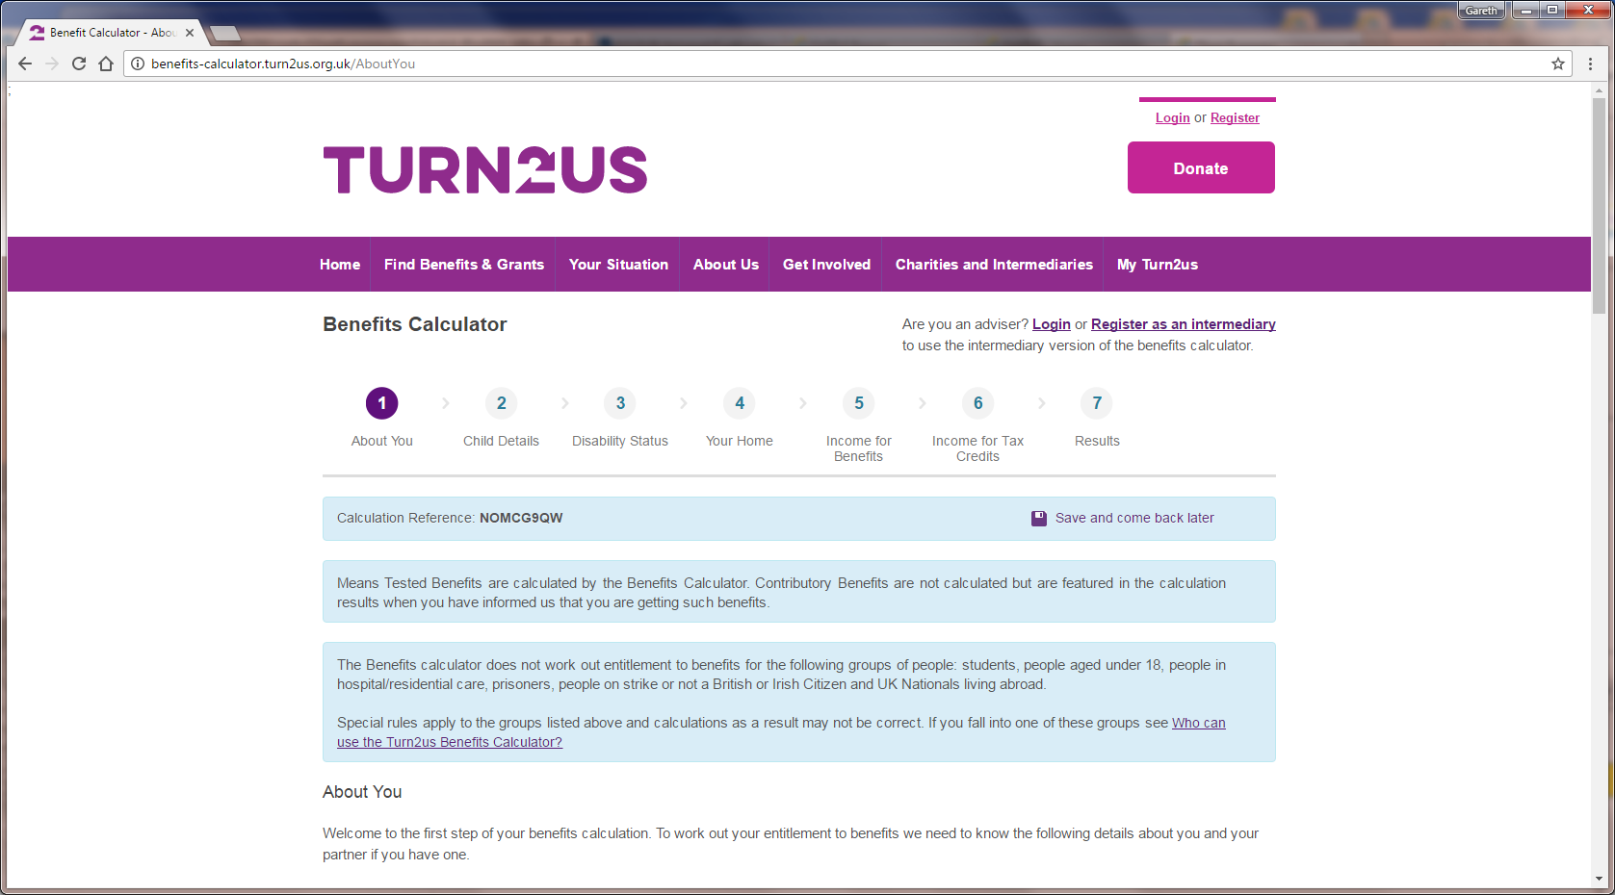
Turn2Us online calculator
Notes:
Free to access, bit slower (asks everything)
Entitled-To works identically

Slide 22

The Entitlement Checking Process
Identify the client’s circumstance
Use a benefit checklist
Consider benefit possibilities
Check eligibility
Check entitlement to non means-tested benefits
Calculate entitlement to means-tested benefits
Notes:
We’ve now looked at all the steps
Session to come on using calc, but (1) will see in office and (2) can practice online
Any Qs???

